Slide 1

Azure AI Services
Azure AI Translation

Slide 2

Introduction to Azure AI Translator
What is Azure AI Translator?
Azure AI Translator is a cloud-based neural machine translation service.
It is part of the Azure AI services family.
Works across all operating systems and languages supported by Microsoft Translator.
Powers Microsoft products like Office, Teams, Bing, and more.
Used by businesses globally to build intelligent, multi-language apps and workflows.
This comprehensive guide covers the three main components: Text Translation, Document Translation, and Custom Translator.

Slide 3
Key Features of Azure Translator
🔡 Text Translation
Real-time source-to-target text translation.
REST API-based and easy to integrate.
Supports detection, transliteration, and dictionary lookup.
📄 Document Translation
Translate multiple files in batch or single file in sync.
Retains original formatting and layout.
Requires Azure Blob storage for batch translation.
🛠️ Custom Translator
Build customized translation models for enterprise use.
Useful for domain-specific vocabularies and brand-specific language.
Integrated with Translator Text API v3.

Slide 4
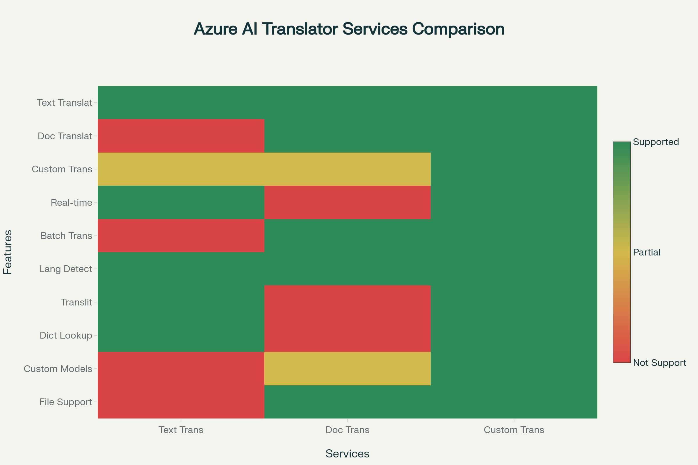

Slide 5
Use Case Scenarios
Global e-commerce portals
Real-time translation of product descriptions and customer reviews.
Multilingual customer support
Translate support tickets, chats, and emails instantly.
Document localization
Automate translation of manuals, contracts, and training material.
Education platforms
Deliver learning content across languages.
Healthcare
Translate patient records and prescriptions securely.

Slide 6
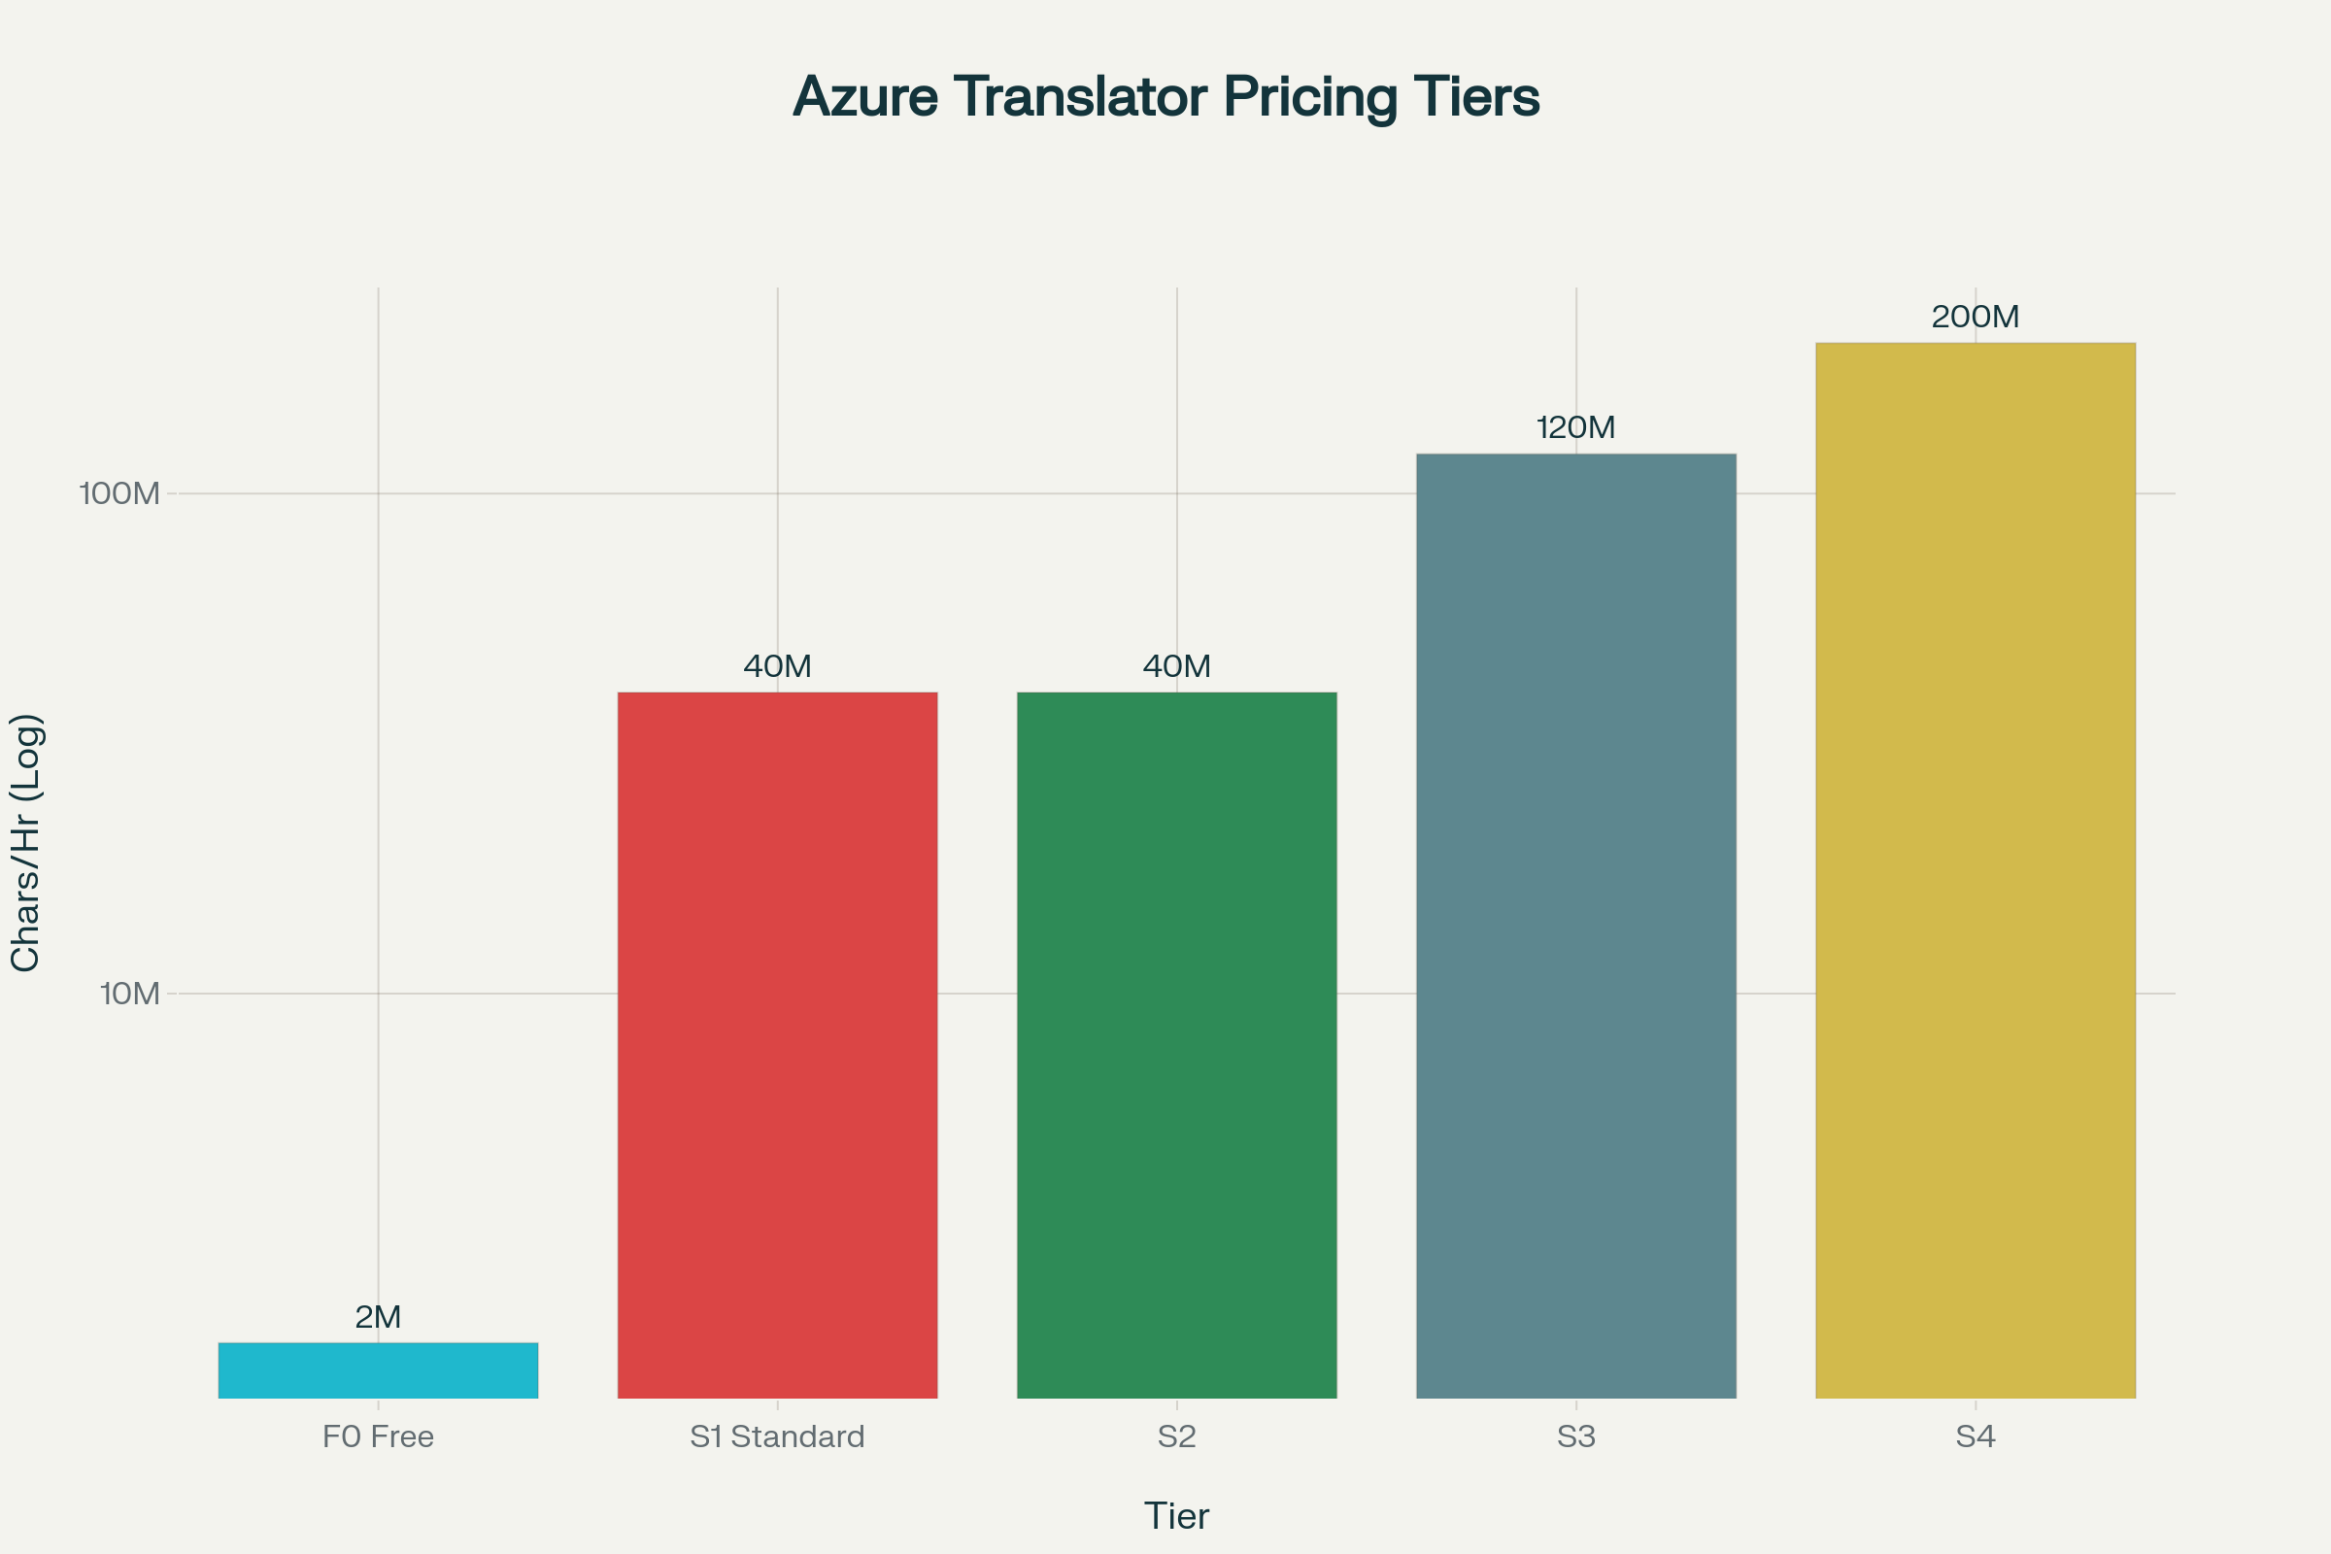

Slide 7
Example - C# .NET Implementation
Steps to use:
Create a translation resource
Get the API endpoint and key
Make the required API call.
class Program
{
private static readonly string endpoint = "https://api.cognitive.microsofttranslator.com/translate?api-version=3.0&to=es";
private static readonly string subscriptionKey = "YOUR_SUBSCRIPTION_KEY";
private static readonly string region = "YOUR_RESOURCE_REGION";
static async Task Main()
{
var textToTranslate = "Hello, how are you?";
var body = new[] { new { Text = textToTranslate } };
var requestBody = JsonSerializer.Serialize(body);
using var client = new HttpClient();
using var request = new HttpRequestMessage
{
Method = HttpMethod.Post,
RequestUri = new Uri(endpoint),
Content = new StringContent(requestBody, Encoding.UTF8, "application/json")
};
request.Headers.Add("Ocp-Apim-Subscription-Key", subscriptionKey);
request.Headers.Add("Ocp-Apim-Subscription-Region", region);
HttpResponseMessage response = await client.SendAsync(request);
string result = await response.Content.ReadAsStringAsync();
Console.WriteLine("Translation Result: ");
Console.WriteLine(result);
}
}
Explanation:
Text: "Hello, how are you?" is translated into Spanish (es).
Subscription Key & Region: Must be from your Azure Translator resource.
Output: Returns the translated result in JSON format.
Real-time: This is a synchronous call to the REST API.

Slide 8
Document Translation
Document Translation extends Azure AI Translator's capabilities to handle entire documents while preserving their original formatting, structure, and layout. This service is particularly valuable for businesses processing contracts, reports, presentations, and other formatted documents.
Supported File Formats and Features
Document Translation supports an extensive range of file formats including PDF (with OCR capability), Microsoft Office documents (DOCX, XLSX, PPTX), HTML files, plain text, CSV, and specialized localization formats like XLIFF. The service can process files up to 40MB in size and maintains document structure during translation.
The service operates in two modes: Asynchronous batch translation for processing multiple documents simultaneously using Azure Blob Storage containers, and Synchronous single file translation for immediate processing of individual documents without requiring cloud storage setup.

Slide 9
Custom Translation
Custom Translator represents the most sophisticated component of Azure AI Translator, enabling organizations to build specialized translation models tailored to their specific industry terminology, style, and context. This service is particularly valuable for domains requiring precise terminology such as legal, medical, financial, or technical documentation.
Model Training Requirements and Process
Custom Translator requires a minimum of 10,000 parallel sentences for training a full model. The training process involves three types of datasets: training data (the core parallel sentences), tuning data (for model optimization), and testing data (for BLEU score evaluation). If only training data is provided, the system automatically generates tuning and testing sets.
The BLEU score (Bilingual Evaluation Understudy) measures translation quality on a scale from 0 to 100, where higher scores indicate better alignment with reference translations. Scores between 40-60 typically indicate high-quality translation systems.

Slide 10
Conclusion
Language Support and Global Reach
Azure AI Translator supports translation between more than 100 languages and dialects, covering approximately 95% of the world's GDP. The service includes major world languages such as English, Spanish, French, German, Chinese (Simplified and Traditional), Japanese, Korean, Arabic, and many others.
The language support extends beyond translation to include transliteration capabilities for 75+ languages, language detection for automatic source language identification, and dictionary services for bilingual term lookup and usage examples.
Security and Best Practices
Authentication and Authorization
Azure AI Translator supports multiple authentication methods including Azure Key Vault for secure credential storage, Managed Identity for Azure resources, and subscription keys for development scenarios. For production deployments, Microsoft recommends using Azure Key Vault to store and retrieve API keys programmatically.
Error Handling and Resilience
Implement comprehensive error handling for common scenarios including quota exceeded (HTTP 429), invalid API keys (HTTP 401), and service unavailable conditions (HTTP 503). The service provides detailed error codes and messages to facilitate troubleshooting.

